Slide 1
NATIONAL youth SERVICE PROGRAMME
KZN Department of Public Works

Slide 2
Background of the nys programme
The NYSP is a government initiative to engage young South Africans in community service activities in order to strengthen service delivery, promote nation –building, foster social cohesion.
The NYSP also assist youth to gain occupational skills necessary to access sustainable livelihood opportunities.
The KZN Dept of Public Works started to implement the Programme in 2007 and has already engaged 328 young people in the programme.

Slide 3
Achievements of the NYSP
168 young people have completed NQF level 3 Skills Programme on Construction Masonry
60 more learners are currently undergoing classroom training on Masonry – NQF level 3
Another group of 60 learners are also being trained on Capentry at NQF level 3
40 Youth Contractors are on the Construction Contracting Learnership at NQF level 2

Slide 4
Impact of the programme
Mncedisi Makoma established a construction while within the NYSP called “First Degree Contractors”
This learner did his practical training at Mbekaphansi Clinic within Maphumulo Municipality.
He has secured a tender from the Maphumulo Municipality to build Low Cost Houses as a sub-contractor of Projecon Construction.
Mncedisi has completed 15 low cost houses at the moment he is still erecting more.
First Degree Contractors has already employed 19 local skilled and unskilled workers.

Slide 5
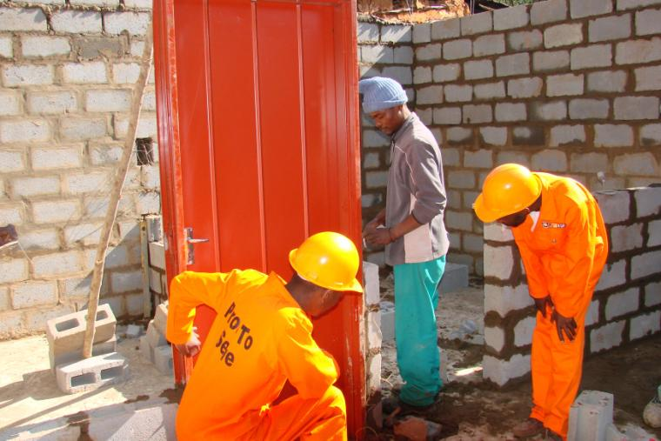
Mncedisi on the right hand side - Monitoring his work

Slide 6
Impact of the programme cont…
Bongiwe Gumede is coming from the INK area did her practical learning at Addington Hospital.
Her mentor, Mr J. Govender realized her skill, potential and commitment to what she was doing.
Today, Bongiwe is a permanent employee of the Durban Maintanance and Building CC which is the construction company under which she served during her training.
She never stops to praise the NYS Programme and how it has laid her where she is today.

Slide 7
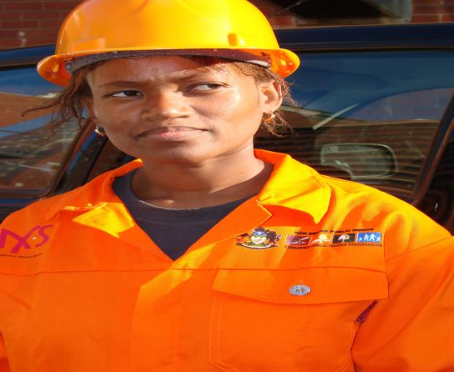
Bongiwe Gumede of durban maintance and buidling cc

Slide 8
Impact of the programme cont…
Another learner, Ms Lungile Ngwazi of Kwa-Dweshula, uMzumbe has also registered a construction company called Ingonyama Construction.
She registered this company while she was under the NYSP being trained on Masonry using the stipend she has been receiving.
Lungile got a tender from Vulamehle Municipality at the value of R45, 000. 00.
Her company is also registered with the Masakhe ECDP database for on-going support.

Slide 9
ngiyabonga
Thank you

